Slide 1







Web Testing ZAMNESIA

Slide 2








SITE DESCRIPTION
| Legal shop
| Europe shop
| Delivery 4-7 days
| 100% PRIVACY

Slide 3
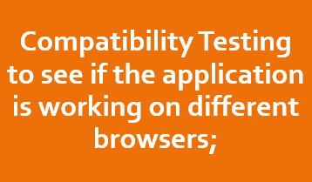



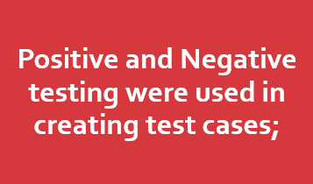


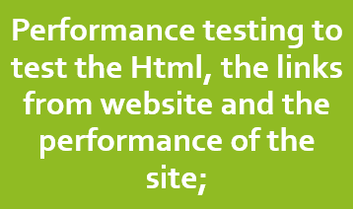

TESTING
APPROACH

Slide 4

TOOLS USED
| Mantis Bug Tracjer – Bug Reporting | 10minutemail – Test Emails | Xmint Tool – Mind Maps | https://alidator.w3.org – for testing errors in HTML | https://pagespeed.web.dev – for testing performance

Slide 5











Testing Types

Slide 6
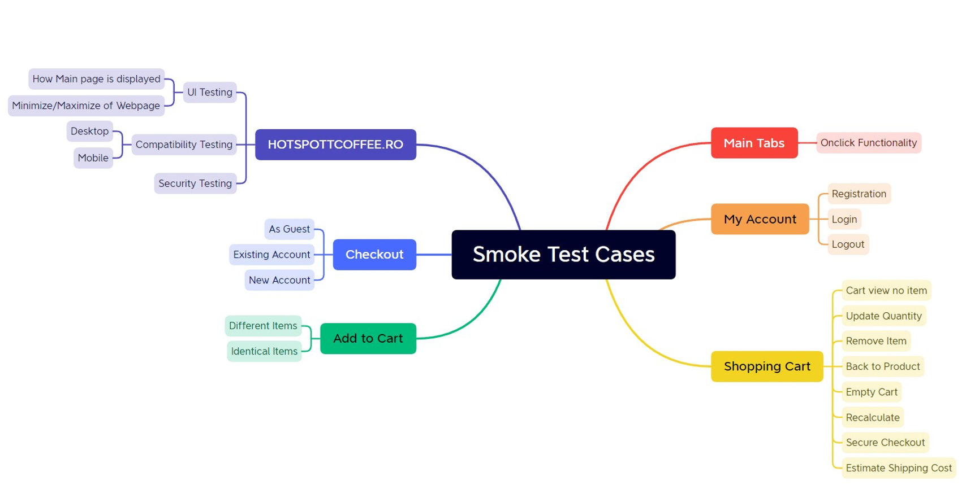


Test cases overview

Slide 7
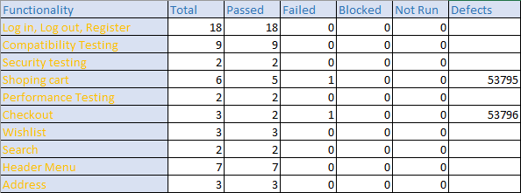
Test cases Results

Slide 8

Conclusions
After testing the site, I understood better how it is arranged
I found very few bugs which is good for the site

Slide 9

LESSONS LEARNED
I learned how to do the work in the tools as efficiently and quickly as possible
I have a better understanding of the types of testing
I learned to think several times before doing something

Slide 10


